Slide 1
The Bechdel Test
Calling attention to gender inequality in fiction
Isabel Rodríguez-Campra
Data Analytics Course
AllWomen

Slide 2



What do they have in common?

Slide 3









What do they have in common?

Slide 4


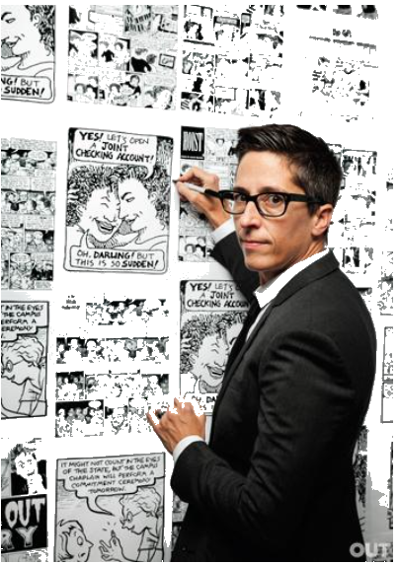
Hello!
She is Alison Bedchel ->

Slide 5
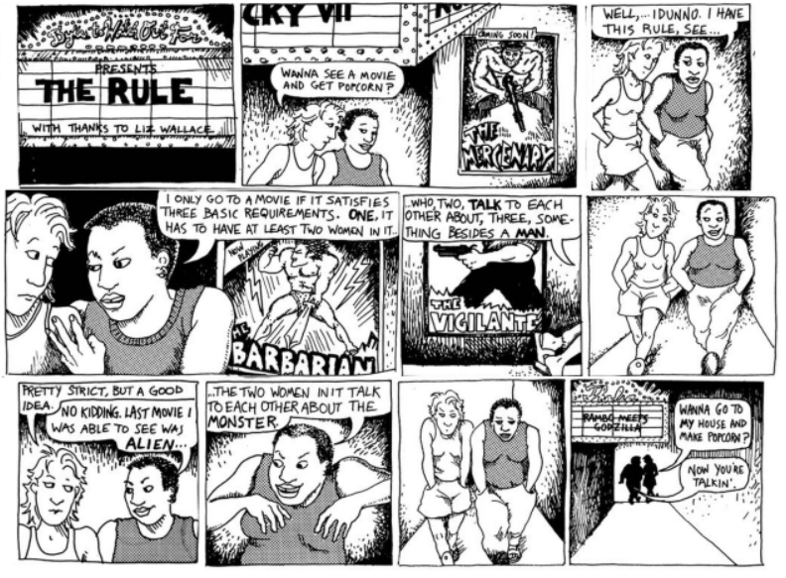
“Dykes to Watch Out For” (Alison Bechdel - 1985 )

Slide 6

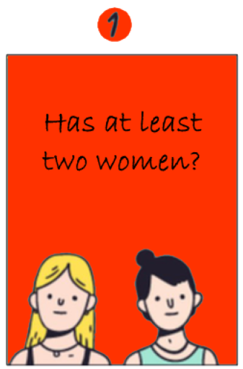


1. The Rule
✔

Slide 7
2. The Bechdel-Wallace Test
It’s a measure for the active presence of women in fiction and one of the most enduring tools to measure Hollywood’s level of gender equality in a film.

Slide 8
GOAL
Analyze the relationship between movies finances, genres and portrayals of women for the last 200 years

Slide 9
3. Data Source
+ 8.800 movies
+ Features
+ Budget & Revenue
+ 1888-2020
http://bechdeltest.com
http://imdb.com
http://the-numbers.com

Slide 10
4. Analyzing Data

Slide 11
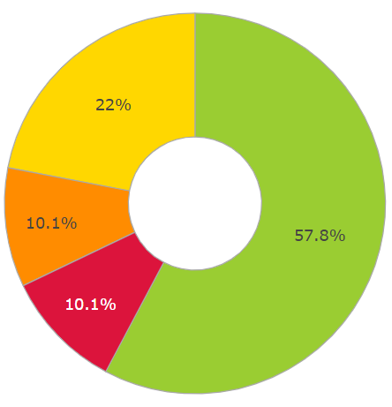
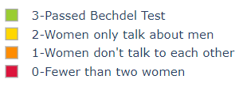
% Distribution of films based on the test

Slide 12
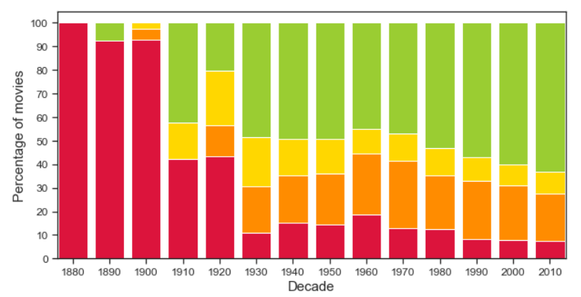
Movies distribution along the decades
?

Slide 13
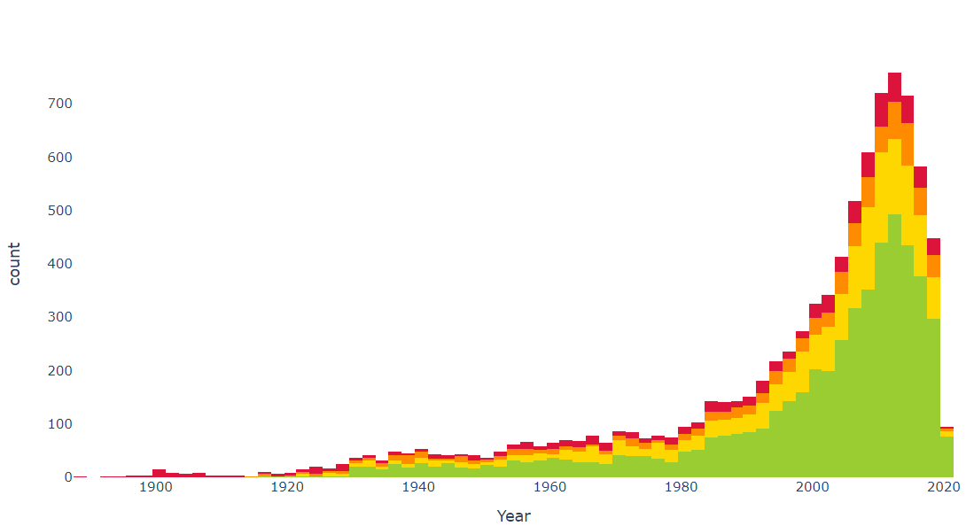
Movies analyzed per release date

Slide 14
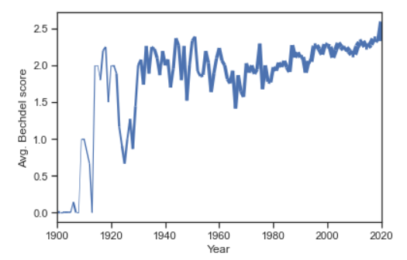
Mean Rating of Movies along the decades

Slide 15
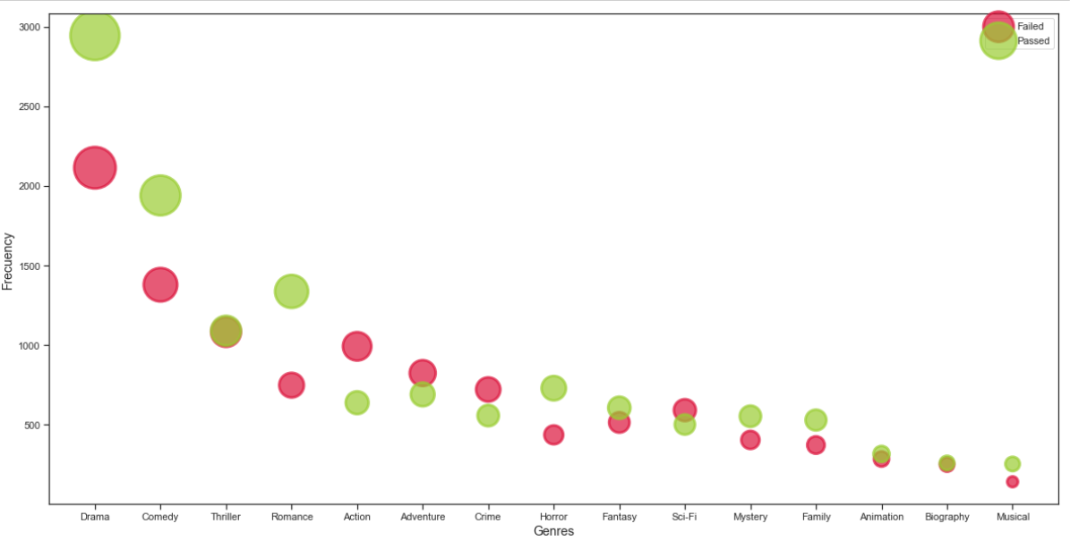
Genre distribution

Slide 16


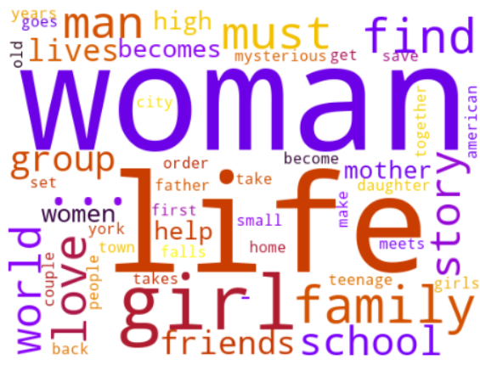
Movie’s most frequent words in the plot description
Fail the Test
Passes the Test

Slide 17
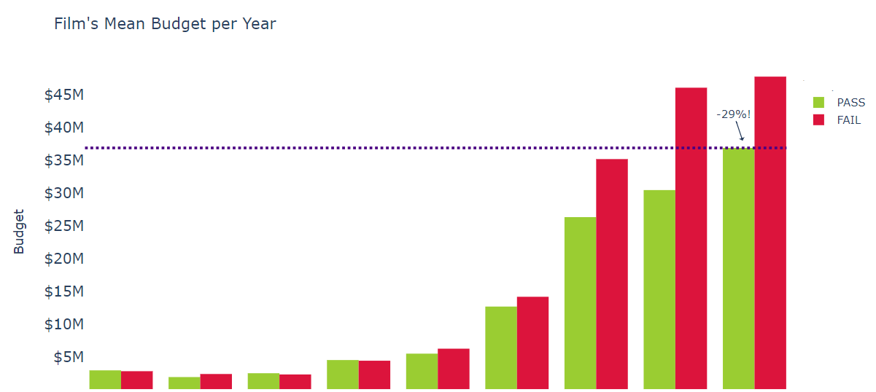
Film’s Mean Budget per Decade

Slide 18
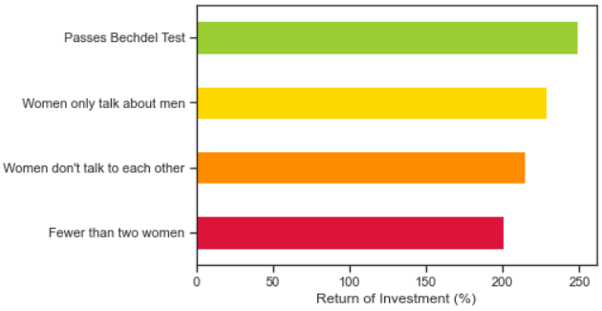
Film’s Median ROI

Slide 19
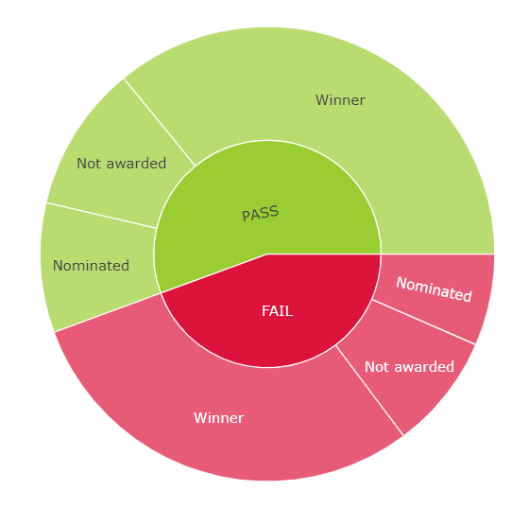
Which movies are more Awarded?
65%
18%
17%
15%
18%
67%

Slide 20
CONCLUSIONS
Nowadays, 40% of the movies don’t have women representation and don’t pass the test
Movies that fail the test have 30% more budget that the ones that pass the test
More budget or less women representation it´s no a guarantee for a best ROI or more awards

Slide 21
CONCLUSIONS
Female representation remains a serious and ongoing problem even within mainstream cinema.
Hollywood industry is still a man’s world, driven by men. Women representation it’s not just about the movie plot, include also directors, writers, etc.
As Bechdel once said, we must represent women as “subjects and not objects.”

Slide 22
Thanks!
Any questions?

